Slide 1


Cross-Platform Spam Detector
An NLP-based system to detect spam across SMS, Email, and YouTube comments
Group 17
Group Members:
P.D.M. Sathsarani
M.K.D.S. Amarasinghe
G. Darshika Nuwangani
Notes:
1

Slide 2


Problem Statement
Multi-Platform Threat
Inefficient Manual Filtering
High Risk
Phishing links, malicious URLs, and deceptive marketing proliferate.
Unsolicited spam spans SMS, Email, and social media comments.
Manual review is slow and error-prone.
Our Solution
Parses raw unstructured text from multiple platforms.
Accurately categorizes content into Spam or Ham (Safe).
Provides confidence scoring and real-time security alerts for users.
Notes:
2

Slide 3
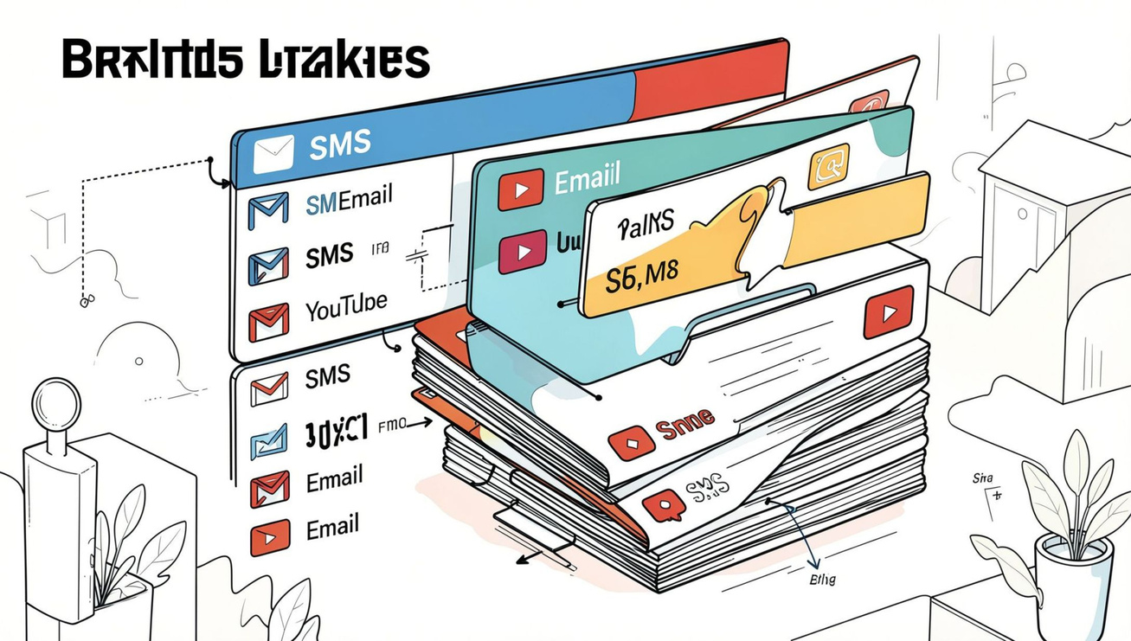
Dataset Summary
SMS
Original Records: 5,572
Clean Records; 5566
(Ham 4,819 / Spam 747)
Email
Original Records: 4845
Cleaned Records:4,770
(Ham 2,662 / Spam 2,108)
YouTube
Original Records:1494
Cleaned Records:1,482
(Ham 780 / Spam 702)
Final Combined Dataset: 11,818 records
Notes:
4

Slide 4
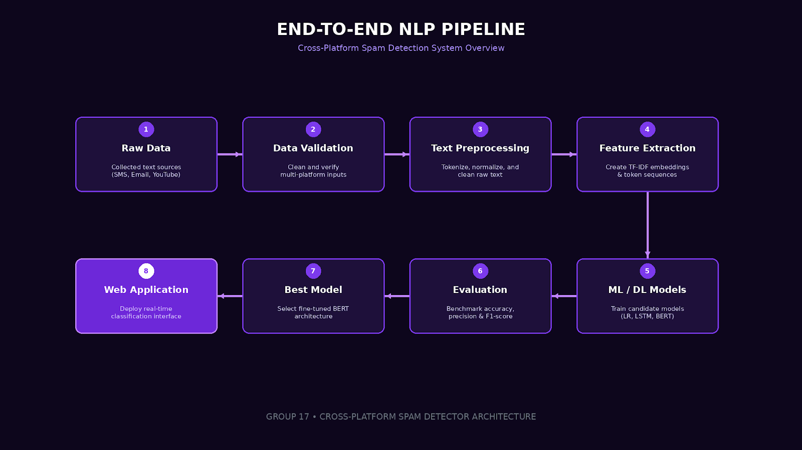
NLP Pipeline (End-to-End)
Notes:
5

Slide 5




Team Contributions & Feature Extraction
P.D.M Sathsarani
M.K.D.S. Amarasinghe
G. Darshika Nuwangani
ML: Logistic Regression (TF-IDF)
DL: LSTM (Tokenization + Padding)
ML: SVM (Linear) (Count Vectorization)
DL: GRU (Tokenization + Padding)
ML: Random Forest (TF-IDF) • DL: BERT (BERT Tokenizer)
Each member developed and tuned one ML and one DL model for rigorous comparison.
Notes:
6

Slide 6
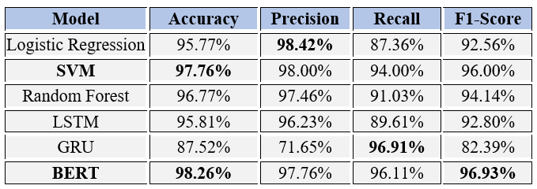
Model Evaluation — Performance Benchmarks
Best ML model — SVM (97.76% Accuracy )
Best DL model — BERT(98.26% Accuracy )
Best Overall: BERT (96.93% F1-Score)
The chart compares overall accuracy across evaluated models; BERT achieved the highest accuracy (98.26%).
Notes:
7

Slide 7
Final Selected Mode: BERT
Why BERT Was Selected?
Highest overall performance
Understands contextual meaning
Uses both left and right context
Suitable for different text styles
Best F1-Score among our models
Result
Accuracy: 98.26%
F1-Score: 96.93%
98.26%
Notes:
8

Slide 8



System Features
Platform Selection
URL Detection
Custom inputs for SMS, Email, or YouTube formats.
Warns users about malicious external web links.
Real-time Analysis
Keyword Highlighting
Instant classification via fine-tuned BERT.
Automatically flags suspicious phishing keywords.
Safety Tools
Confidence Score
Confidence scores, keyword highlighting, and URL warnings.
Displays prediction certainty percentage.
Notes:
9

Slide 9

Ethical Consideration
Risks:
dataset bias,
privacy concerns
false positives/negatives,
over-reliance on automation
Mitigations:
diverse datasets
data anonymization
transparent confidence metrics,
human oversight

Slide 10

Conclusion & Next Steps
Milestones
Final Selection
Call to Action
Consolidated 11,818 clean entries; benchmarked 6 models; deployed a web app with live demo.
Selected BERT for production: 98.26% Accuracy, 96.93% F1.
Integrate with platform partners, expand data diversity, and maintain human review for edge cases.
Notes:
10

Slide 11
Thank you!
Questions & Answers
Cross-Platform Spam Detector • Group 17

